Slide 1
WFI System
Clean Steam
POUs
Distillation
Column
Feed Water
QC
HE
POUs
Pretreatment
(Nanofiltration & UV Sterilization, Conductivity)
Polishing
(Reverse Osmosis)
PW
Storage
Pump
HE
POUs
Multi Step Distillation
HE
WFI
Storage
Pump
Notes:
QC: Probennahme
PW: purified Water
He: Heater

Slide 2
Characteristics
Minimize dead legs -> avoid stagnant of water
Material = Stainless Steel 316L
Constant turbulent flow
Positive pressure between the loop and Points of use (POUs)
Adequate slope of piping toward the drains
Air breaks to wastewater
7. Two pumps for redundancy
Pumps between -> Nano & Reverse Osmosis
-> PW storage and loop (twice)
-> WFI storage and loop (twice)

Slide 3
Points Of Uses / Interceptions -> see excel
Flows | USP | DSP | Buffer & Media Preparation
Feed Water
PW
WFI
Clean Steam
Process Air (clean)
Compresses Cleaned Air
Process Gases
Liquid Nitrogen

Slide 4
Points Of Uses -> see excel
USP | DSP | Buffer & Media Preparation

Slide 5
Equipments Clean Utilities
PW | WFI | Clean Steam | Clean Compressed air | Process Air (HVAC) | Process Gases (N₂, O₂, CO₂,H₂O₂₎ | Liquid Nitrogen
Inside | Inside | Inside | Inside | Inside | Outside | Outside
Heat exchanger | Heat exchanger | Distillation Column | Filters | Filters | Storage Tanks for all gases | Storage Tank
Storage Tank | Storage Tank | Compressor | Pneumatic Valve | Cooler | Pneumatic Valve | Pneumatic Valve
Reverse Osmosis | Distillation Column |  | Storage | Heater + Reheaters
Nano Filtration |  |  | Compressor | Humidifier
 |  |  |  | Mixing Chambers
For Feed Water -> small extra tank???

Slide 6
WFI / PW Estimation
Estimation from the Process Description file -> Waiting for feedback from DSP and B&M Prep
Product | WFI Volume (per batch) [L] (DSP) | Buffer Volume [L] | Buffer volume (125%) [L] | PW (USP)
Product A | 3541 | 35962 | 44952 | 2500
Product B | 3541 | 35435 | 44294 | 2500
Product C | 3616 | 34770 | 43462 | 2500
Product D | 3541 | 36671 | 45838 | 2500
Total | 14239 | 142838 | 178546 | 10000

Slide 7
appendix

Slide 8
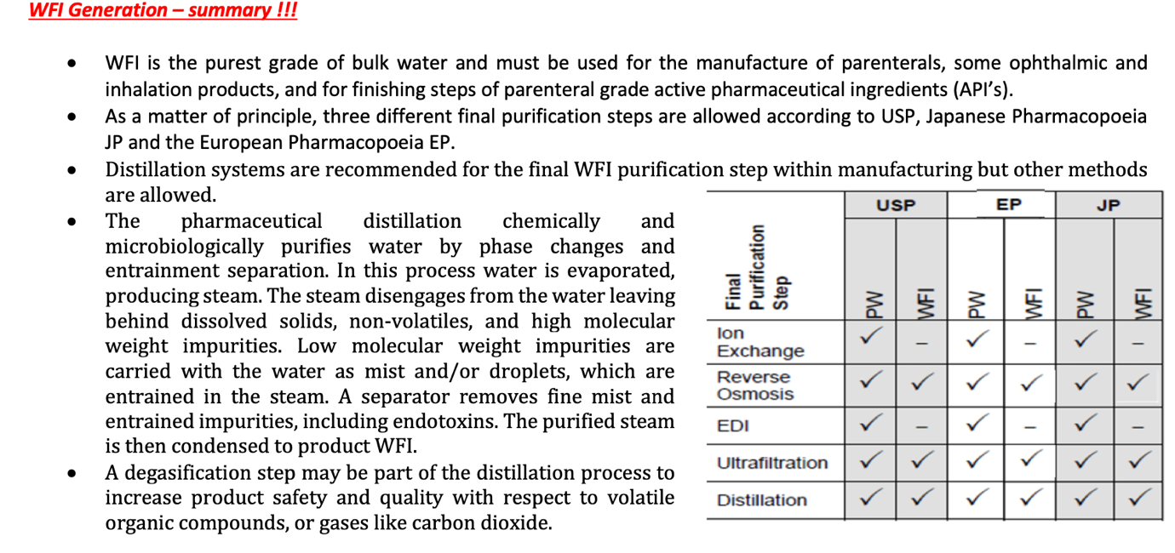
Just as help

Slide 9
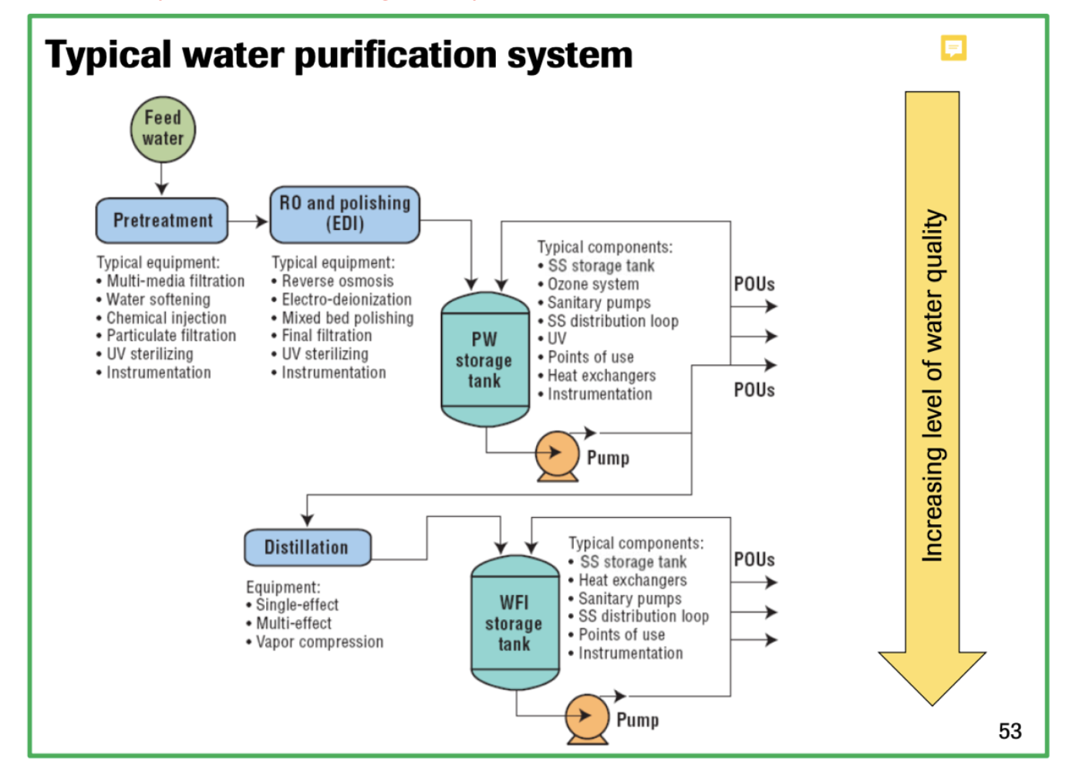
Just as help

Slide 10
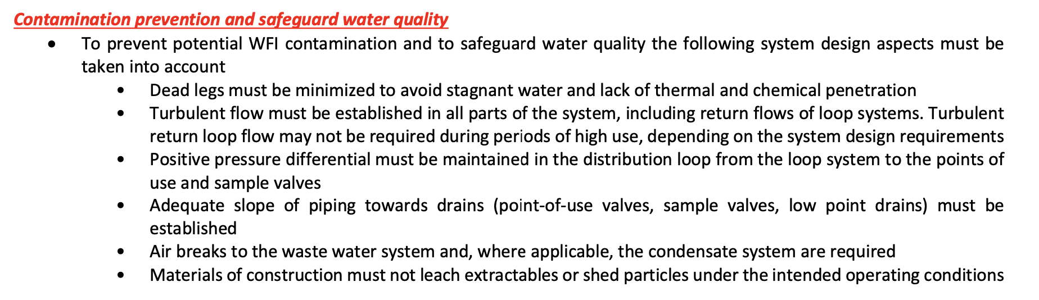
Just as help

Slide 11











Corridor
Media prep
Media
storage
Administration
Material Airlock
Personnel Airlock
D Class
Inoculum
C Class
Corridor
CNC
Personnel Airlock
NC
USP Production
Buffer prep & storage
DSP V+
Material Airlock
Personal
Product
Waste
Material
USP harvest
Process Gases (N₂, O₂, CO₂)
Personnel Airlock
Liquid Waste
Solid Waste
PA
PA
Biological Liquid Waste
Corridor
Personnel Airlock
Clean Steam
PA
DSP Storage
Quality Control
Process Air
PA
DSP freezing
WFI
Personnel Airlock
PA
PA
Cooling Water
DSP V-
PA
PW
Personnel Airlock
Clean Compressed Air
Notes:
noice

Slide 12
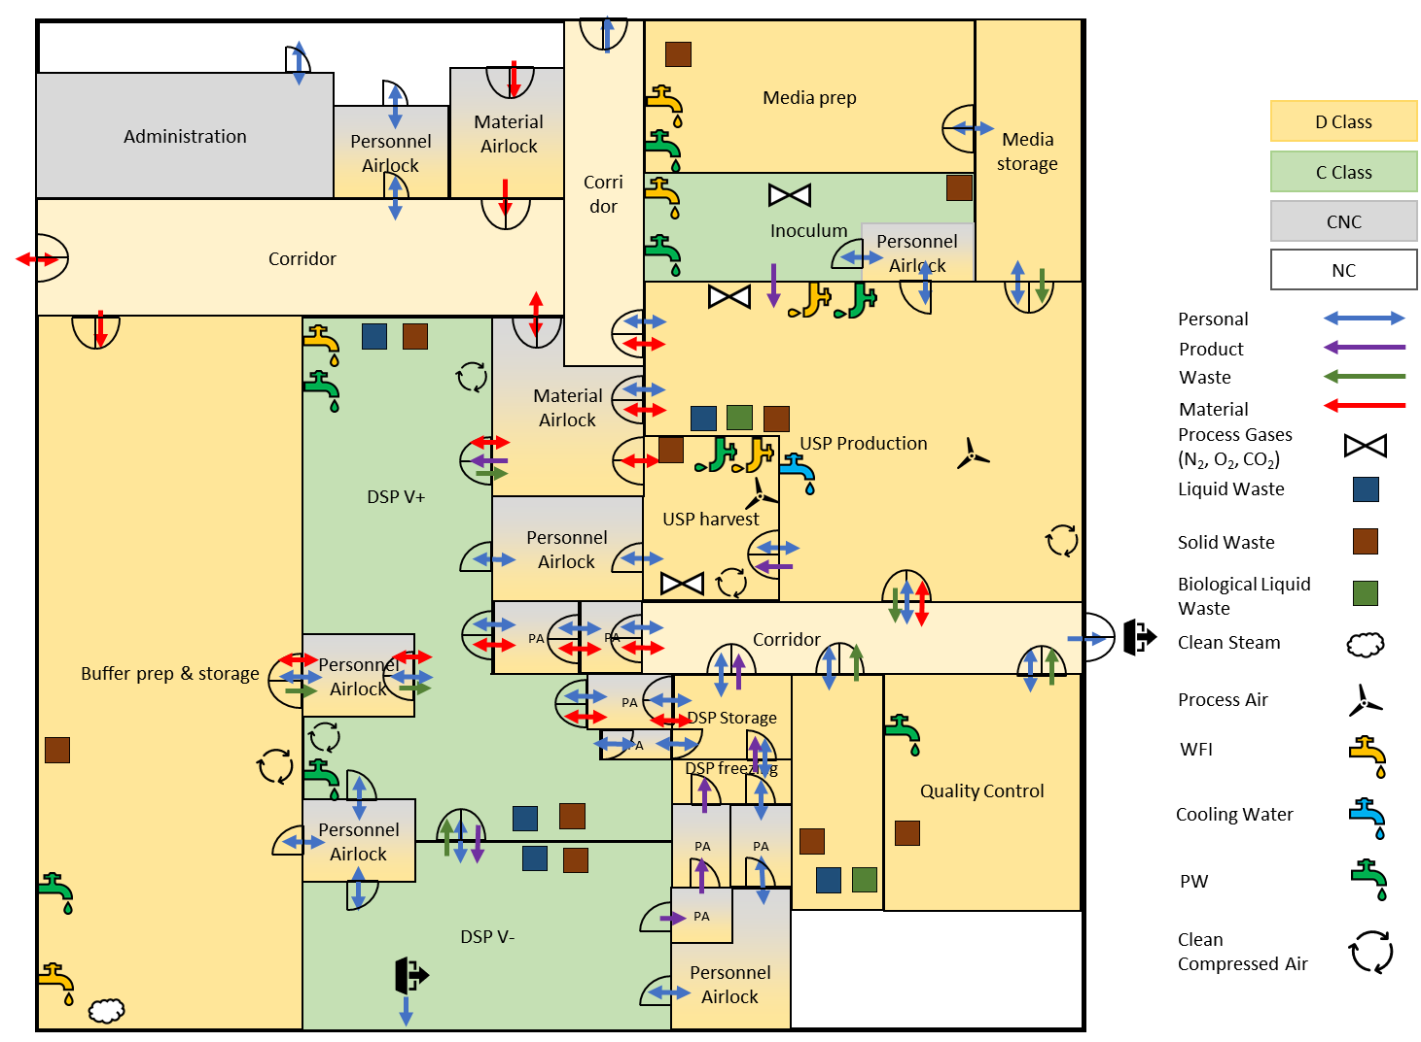

Slide 13
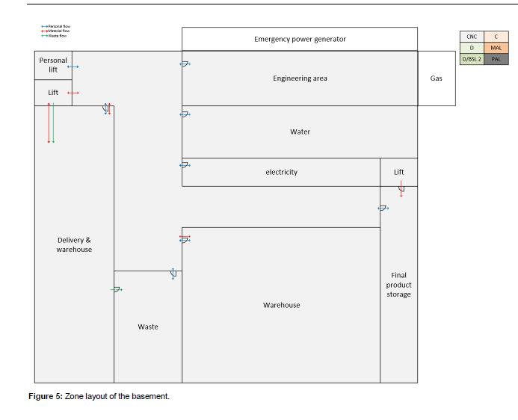
Waste Management
Elevator
Stairs
Engineering
Data Storage
Electricity & Emergency Generators
Stairs
Elevator
PW and Feed Water
WFI & Steam Production
Notes:
Basement

Slide 14
Elevator
Stairs
Administration
Personnel Airlock
Material Airlock
Corridor
USP Production
Warehouse
Material Airlock
Corridor
Buffer prep
Buffer storage
DSP V+
Material Airlock
USP harvest
Text hinzufügen
Personnel Airlock
Corridor
Personnel Airlock
DSP Polishing V+
DSP storage
Quality Control
Stairs
Elevator
Personnel Airlock
DSP V-
Personnel Airlock
Notes:
Basement

Slide 15


2. floor
5 m
HVAC
The Office
1. floor
5 m
Warehouse
Storage
Ground floor
Entrance
1 m
Crawl space
7 m
Buffer prep.
Upstream
Downstream
5 m
3 m
Personnel/
Material airlock
Containment
Basement
3 m

Slide 16
PRESENTATION

Slide 17
Clean Utilities
 | WFI Volume per batch [L] | PW Volume per batch [L] | Solid Waste Volume per batch [L] | Liquid Waste Volume per batch [L] | Liquid Biological Waste per batch [L]
DSP | 3541 | - | 625 | 42000 | -
USP | - | 2500 | - | - | 2500

Slide 18
Equipments Clean Utilities
PW | WFI | Clean Steam | Clean Compressed air | Process Air (HVAC) | Process Gases (N₂, O₂, CO₂₎ | Liquid Nitrogen
Basement | Basement | Basement | Basement | 2.nd Floor | Outside | Outside
Heat exchanger | Heat exchanger | Distillation Column | Filters | Filters | Storage Tanks for all gases | Storage Tank
Storage Tank | Storage Tank | Compressor | Pneumatic Valve | Cooler | Pneumatic Valve | Pneumatic Valve
Reverse Osmosis | Distillation Column |  | Storage | Heater + Reheaters
Nano Filtration |  |  | Compressor | Humidifier
Water Treatment |  |  |  | Mixing Chambers
Notes:
We did a list of the main equiptment used for the clean utilities and where it is

Slide 19
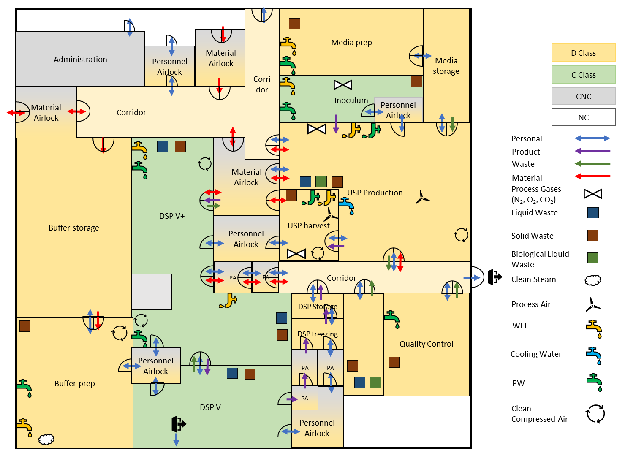
HVAC And Points Of Use Zone Concept

Slide 20
Points Of Uses

Slide 21
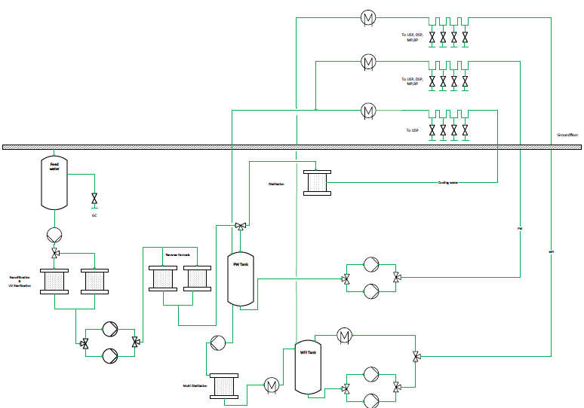
WFI & PW and
Clean Steam System

Slide 22
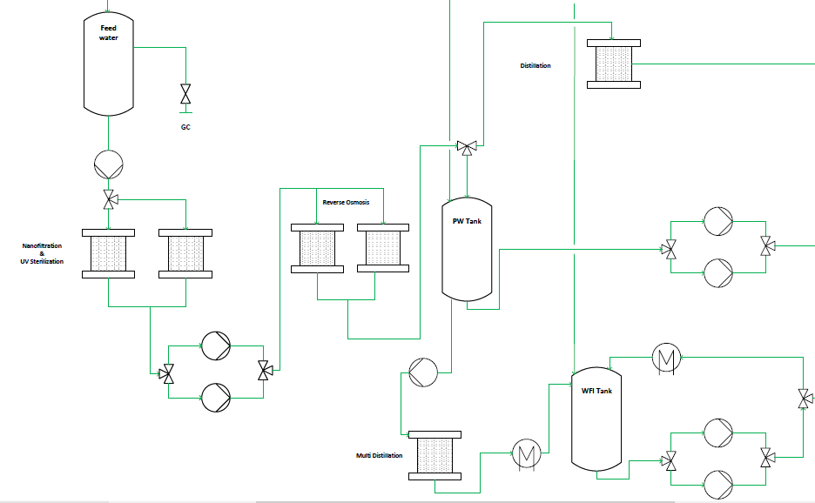
Notes:
Valve missing, probennahme

